Slide 1
Basic Concepts of Hadoop
Karthick Selvam

Slide 2
Hadoop History
Oct 2003: Google File system paper published
Dec 2004: Jeffrey Dean & Sanjay Ghemawat from Google published MapReduce paper called “MapReduce: Simplified Data Processing on Large Clusters”
Jan 2006: Above MapReduce Paper inspired Doug cutting, a yahoo employee then to develop an open source implementation of MapReduce framework
Jan 2006: Hadoop subproject created as extension of Apache Nutch project, created by Doug Cutting.
Apr 2006: Hadoop 0.1.0 released
May 2006: Yahoo deploys 300 machine Hadoop cluster
2008: Cloudera, one of the major distributor of Hadoop founded

Slide 3
Hadoop History
Apr 2007: Yahoo runs 2 clusters of 1,000 machines
Jul 2008: Hadoop wins Terabyte sort benchmark (1st time a Java program won this competition)
Jun 2010: Yahoo 4,000 nodes/70 petabytes
Jun 2010: Facebook 2,300 clusters/40 petabytes
Dec 2011: Apache Hadoop release 1.0.0 available
2011: Hortonworks, another major Hadoop distributor founded
Oct 2013: Apache Hadoop release 2.2.0 (YARN)
Dec 2015: Apache Hadoop release 2.6.3 available

Slide 4
Hadoop History
Feb 2016: Apache Hadoop release 2.6.4 available
July, 2018 : Apache Hadoop release 2.7.7 available
May, 2018:Apache Hadoop release 2.8.4 available
May, 2018: Apache Hadoop release 2.9.1 available
May, 2018 : Apache Hadoop release 3.0.3 available
Aug, 2018: Apache Hadoop release 3.1.1 available
Hadoop was named after Doug Cutting’s son’s toy elephant

Slide 5
Hadoop Introduction
Processing of this Bulk volume of data with limited computing resource means how long it will take?
Storage
100 TB DATA
Computing
Pentium 4 processor and 1 gb ddr2 of ram

Slide 6
Hadoop Introduction
Apache Hadoop is the framework for distributed storage and computing( combination of Processor and RAM) model to deal with large volume of data.
Apache Hadoop is a collection of open-source software utilities that facilitate using a network of many computers to solve problems involving massive amounts of data and computation. It provides a software framework for distributed storage and processing of big data using the MapReduce programming model.

Slide 7
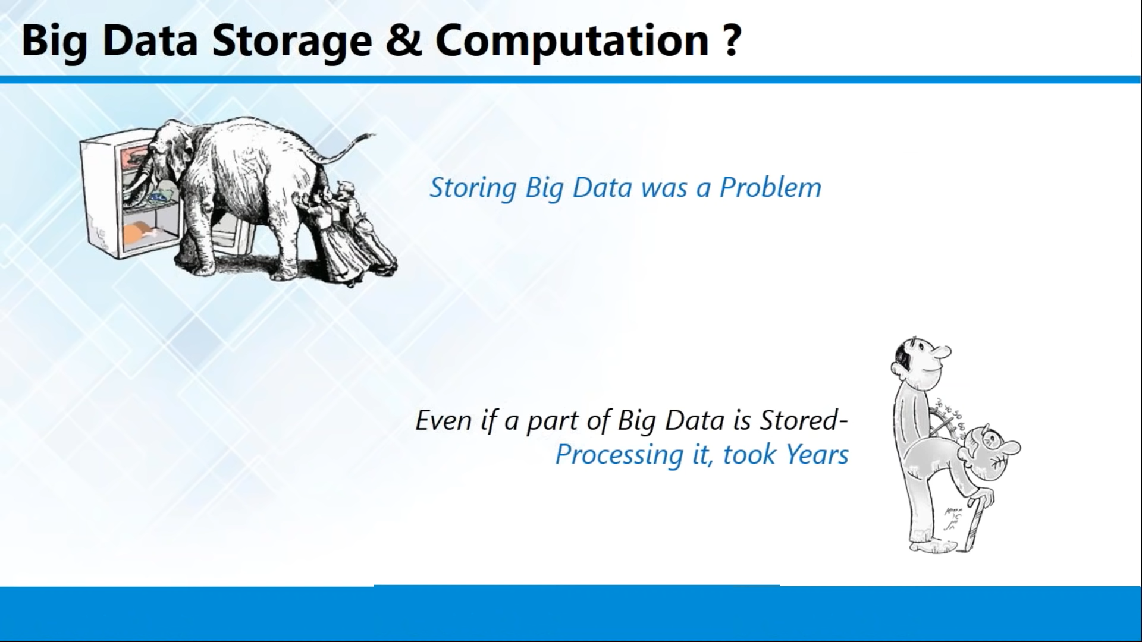

Slide 8
HDFS
1 file that will be of 2 TB storage

Slide 9
File System
Fat
Fat32
Ntfs
Ext1
Ext2
Ext3
Ext4
Oracle file system

Slide 10
HDFS Introduction
HDFS
Because of some limitations that will be avail on each and every file system by means of minimum and maximum volume it will support, minimum and maximum file size it will support , platform dependencies will be there.
To overcome with all those difficulties and with some extra features to handle the large volume of data Hadoop came up with some filesystem called as Hadoop Distributed file system that will only used in Hadoop framework.

Slide 11
MAP REDUCE
Logical unit of Separate computing and storage point
10 TB of Storage(HDFS)
800 Core Processor and 400 GB of ram(MAPREDUCE)
8 core processor
4 GB of RAM
100 GB of HD

Slide 12
MAP REDUCE
Mapreduce is nothing data processing model in Hadoop frame work
It a logical combination of CPU and RAM
If in the case of handle the Hadoop frame work data's this computational unit will act as processing model and it will complete the work as early as possible with the help of logical unit.

Slide 13
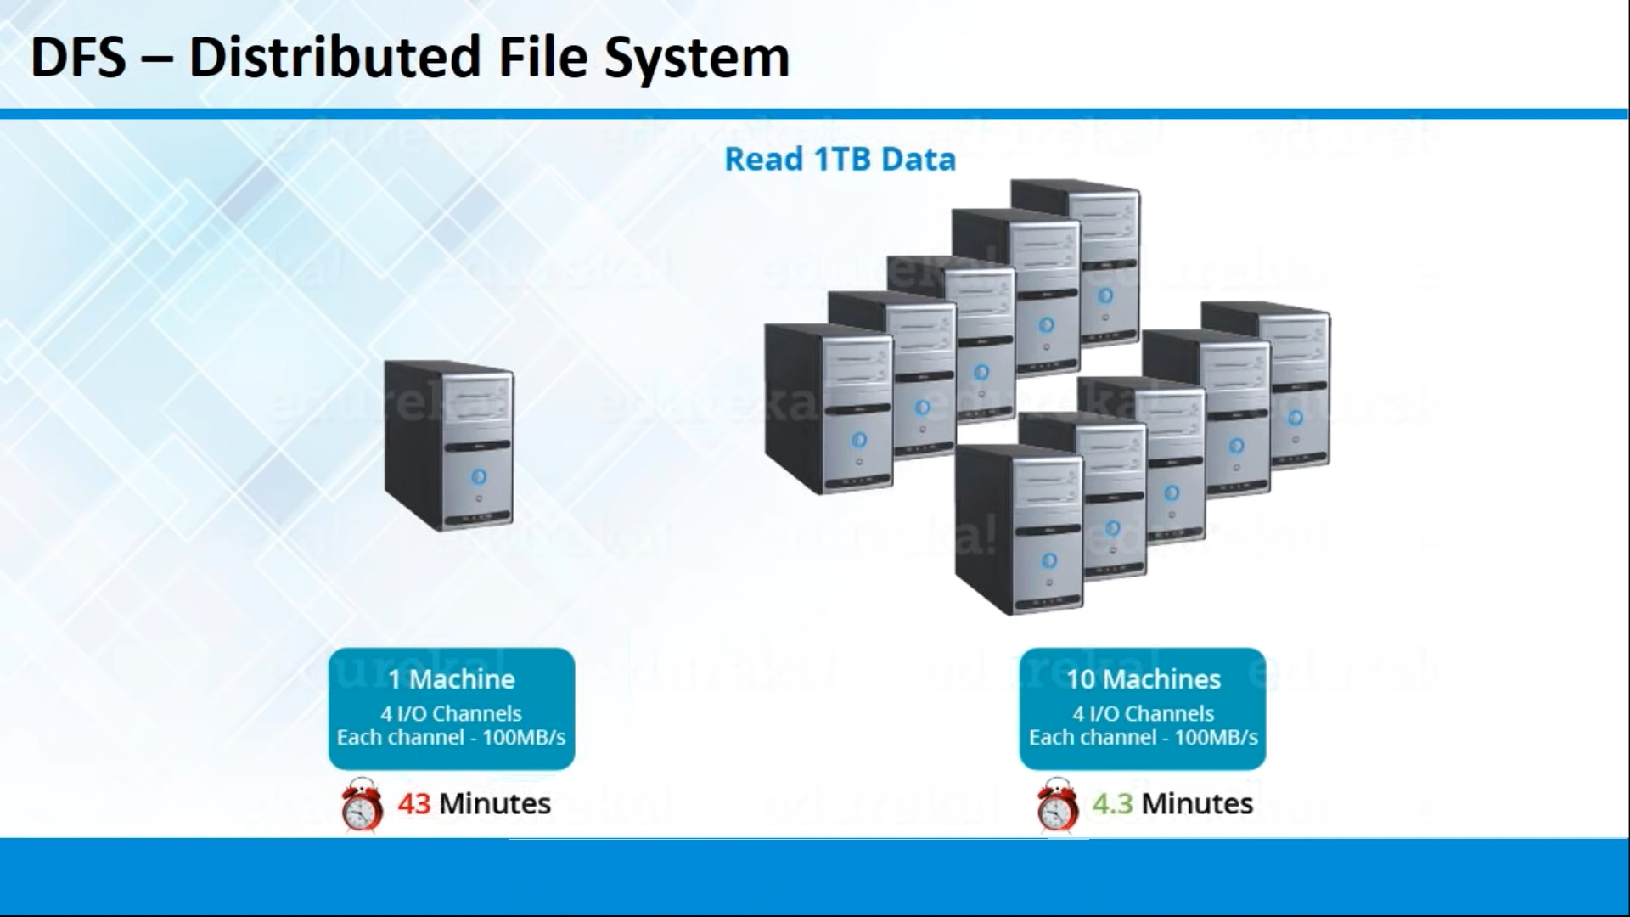

Slide 14
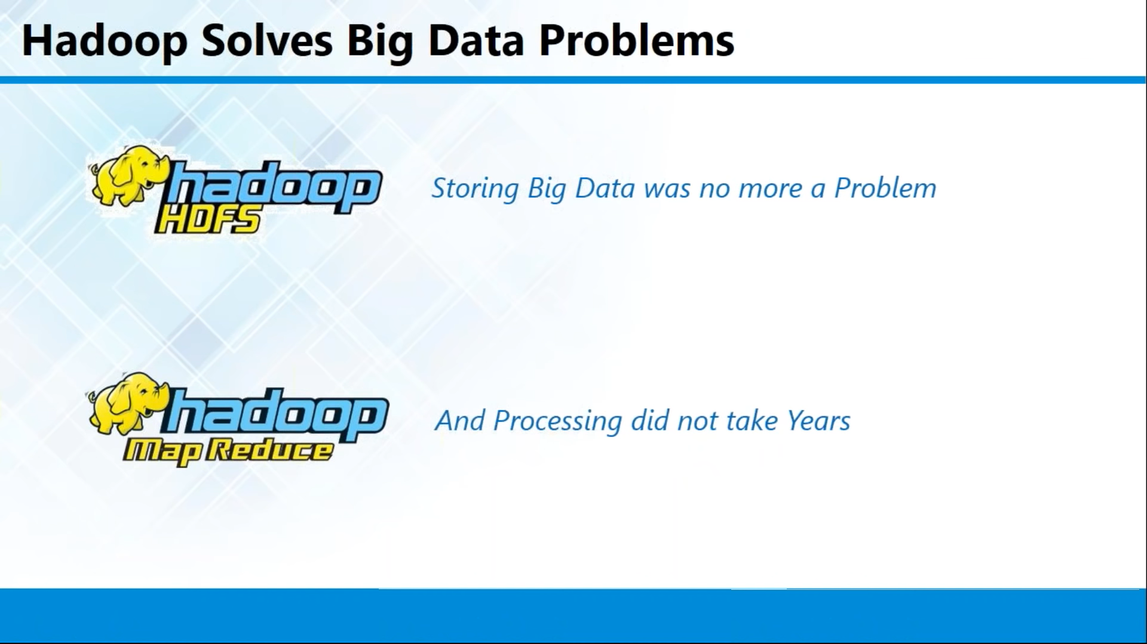

Slide 15
Hadoop Components
Hadoop Came up with 2 components
Storage(HDFS)
Processing(MAPREDUCE)

Slide 16
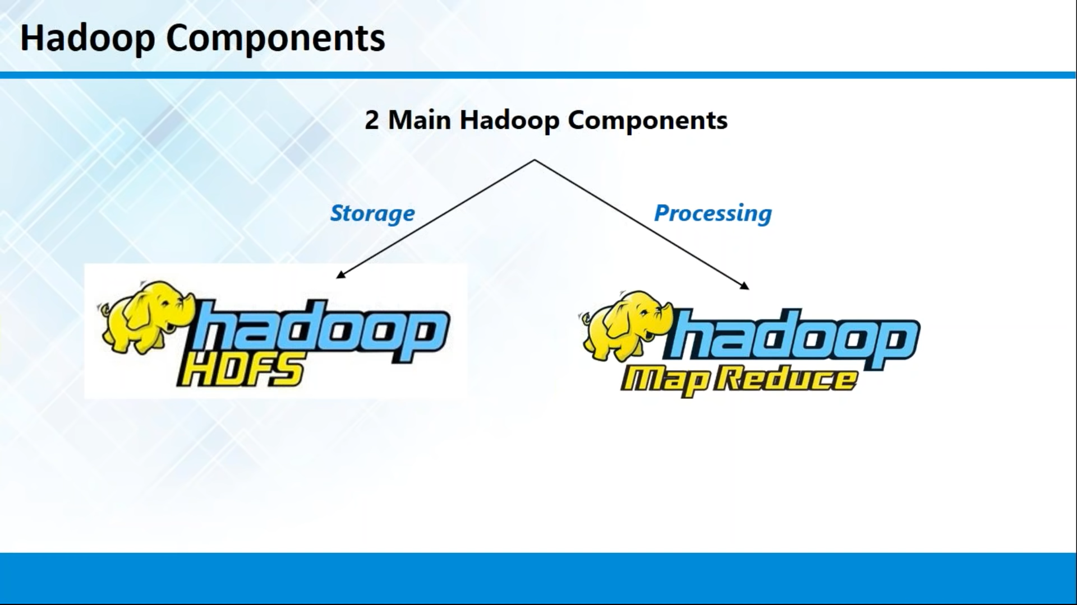

Slide 17
Hadoop has been developed by the base language is java
In Hadoop if u want to do any work means, give the input as java program code
It will revert u back with output also as java format

Slide 18
If in the case of Cluster Architecture it will be in the structure master/slave architecture
One master/multiple slave architecture means if master node fails what will happen?
In Master slave architecture based software, especially in the case of single master architecture, they will write an algorithm to select the new master from one of the slave node in the cluster
Election process will be based on latency, performance(latency is nothing but time taken for one successful communication)

Slide 19
Hadoop 1.0
Map Reduce(processing unit) for Cluster resource management and data processing
Master
Slave
HDFS(storage unit) for redundant and reliable storage
Master
Slave

Slide 20
Components of Hadoop1.0
HDFS(Storage)
Name Node
Data Node
MapReduce(Processing)
Job Tracker
Task Tracker

Slide 21
10 TB
10 TB
10 TB
10 TB
10 TB
Master
50 TB

Slide 22
HDFS
Name node and data node are sub components of HDFS
Name node present only in Master
Data node present in all the Slave
Name Node
Name Node only stores the metadata of HDFS – the directory tree of all files in the file system, and tracks the files across the cluster.
Name Node does not store the actual data or the dataset.
Data Node
The data itself is actually stored in the Data Nodes.

Slide 23
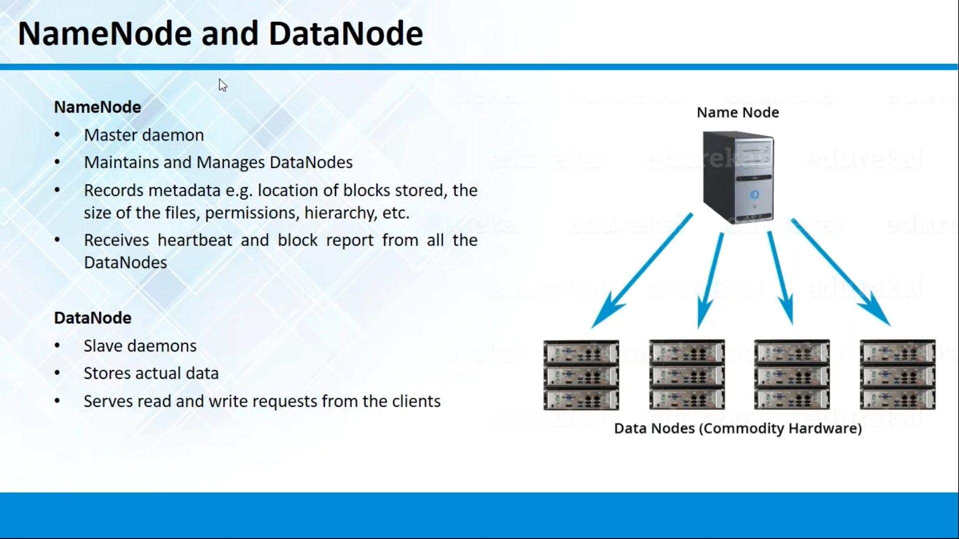

Slide 24
HDFS
All the files that are stored in the format of block
Each and every blocks will be in the size of 64MB in Hadoop 1.0 and 128MB in Hadoop 2.0
For example I got file size will in 500 Mb means
In 1.0 architecture first 7 blocks will 64mb last block will be in 52mb size
In 2.0 architecture first 3 will be 128MB last 116 MB

Slide 25
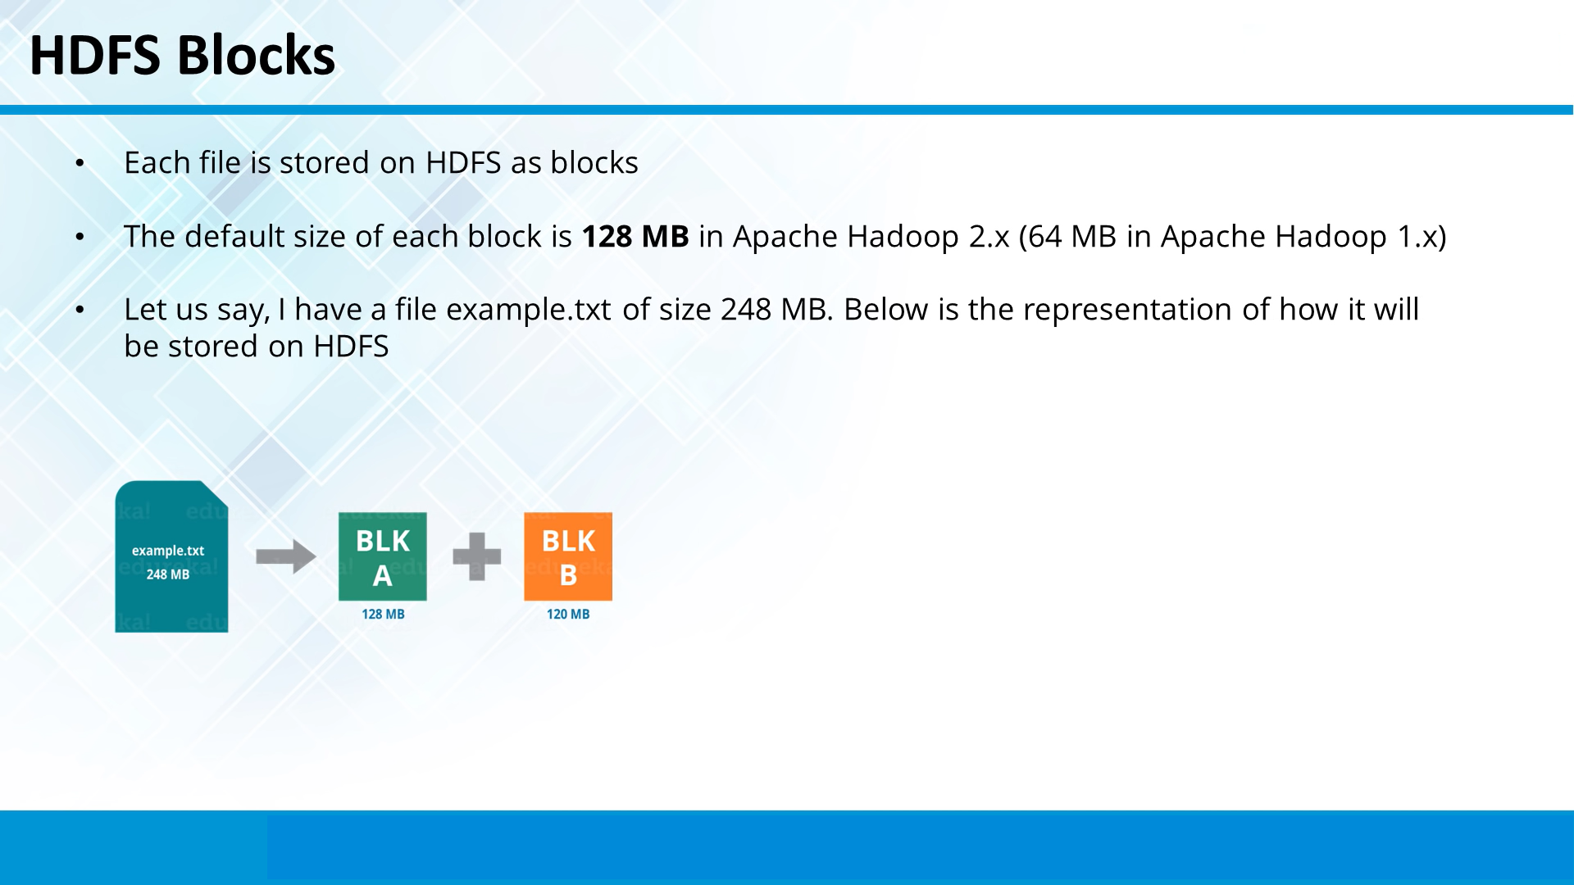

Slide 26
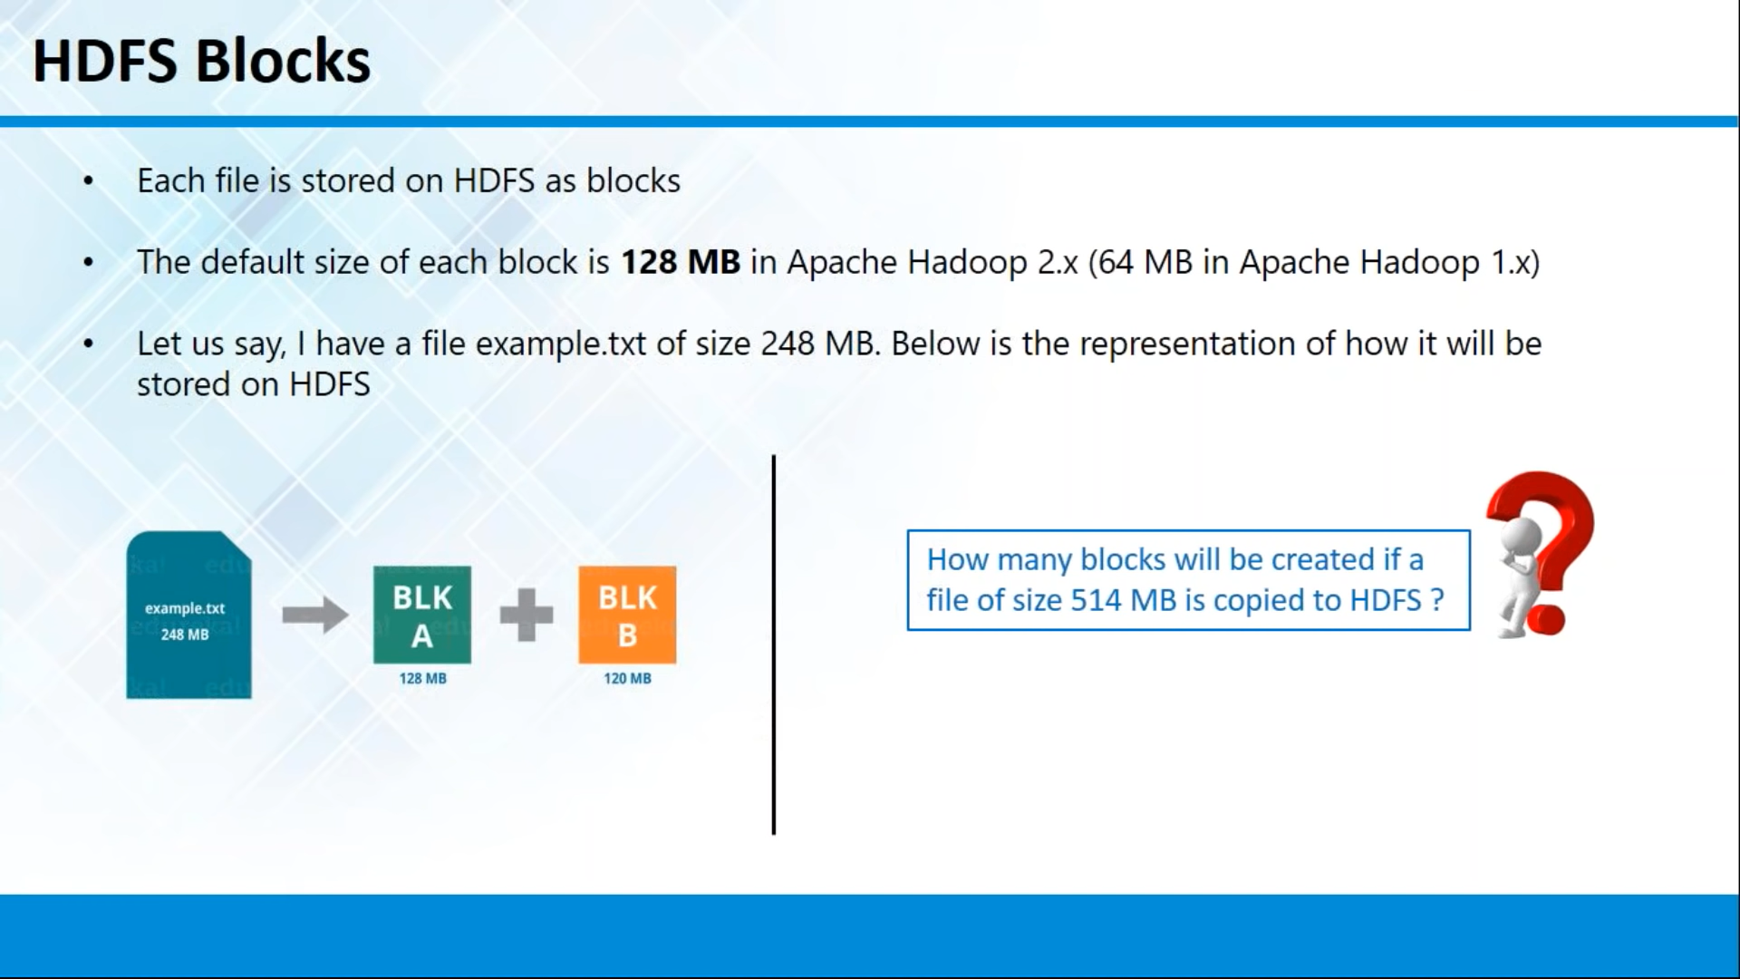

Slide 27
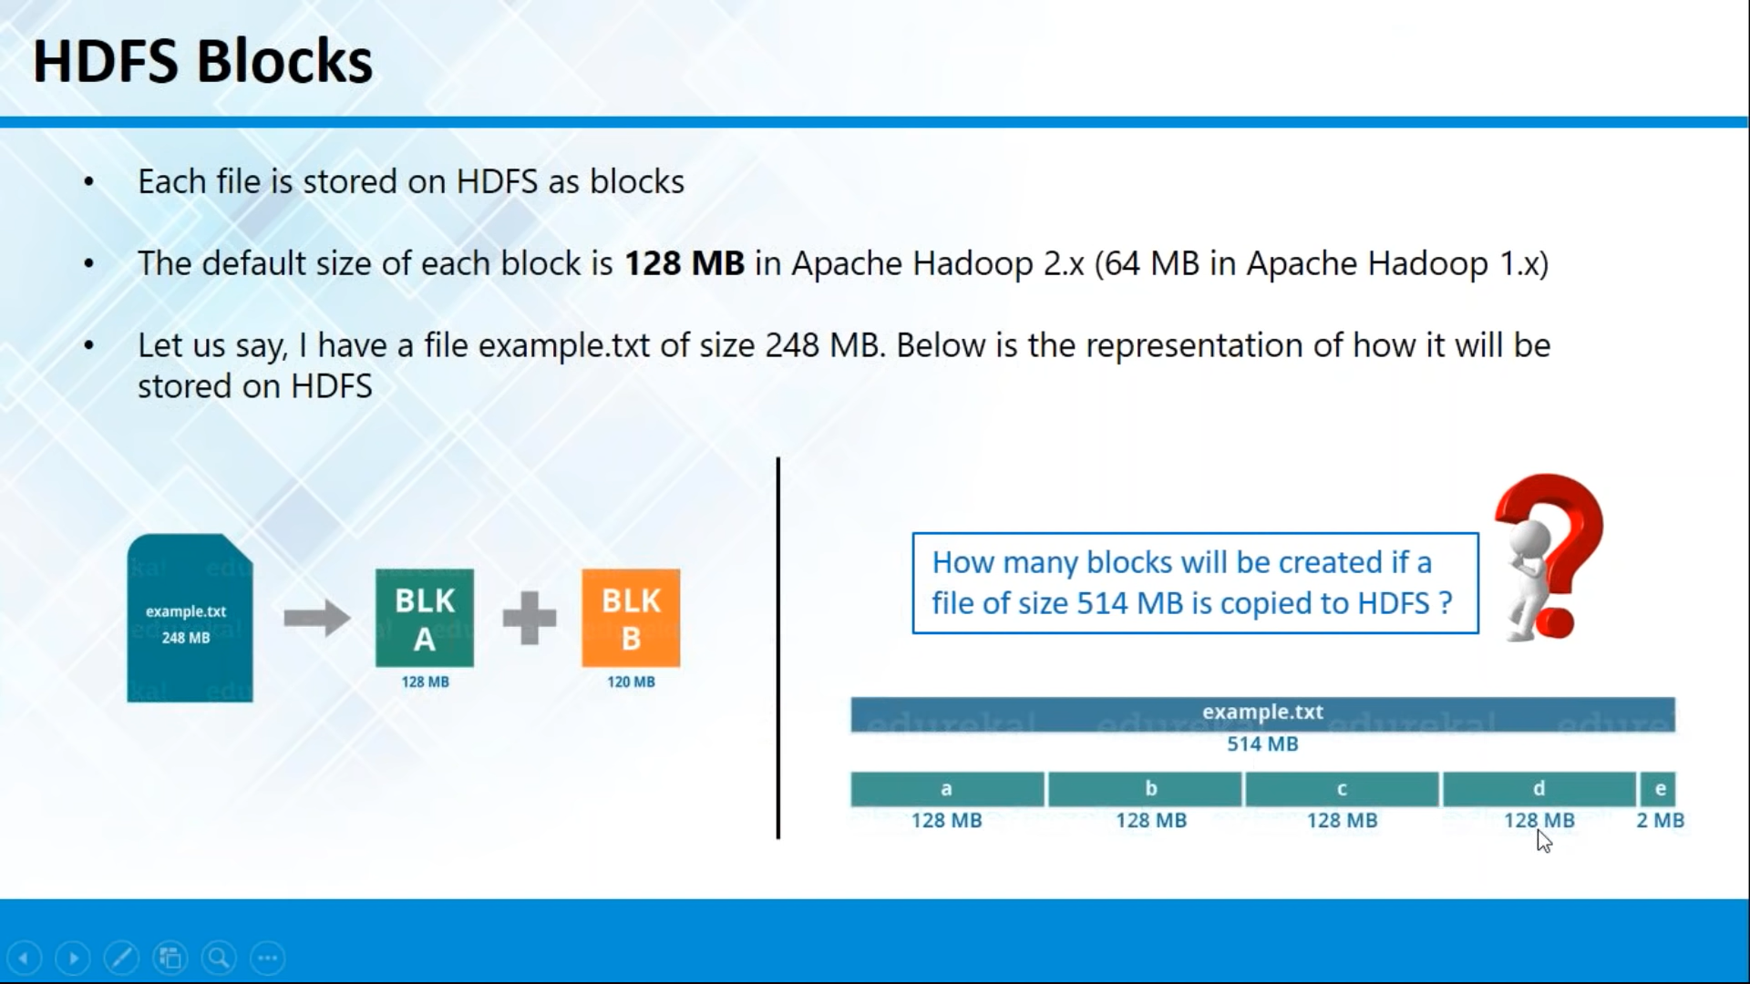

Slide 28
Rack Awareness Algorithm
Rack Awareness is an algorithm to main the effective replication policy over the Hadoop architecture
in Hadoop each and every blocks have 1+2 replication policy by default
Ex 2 tb that 2 tb has been saved as 6tb data(need of replication)
Computing Resource is cheaper no Storage resource is cheaper?
Storage is Cheaper

Slide 29
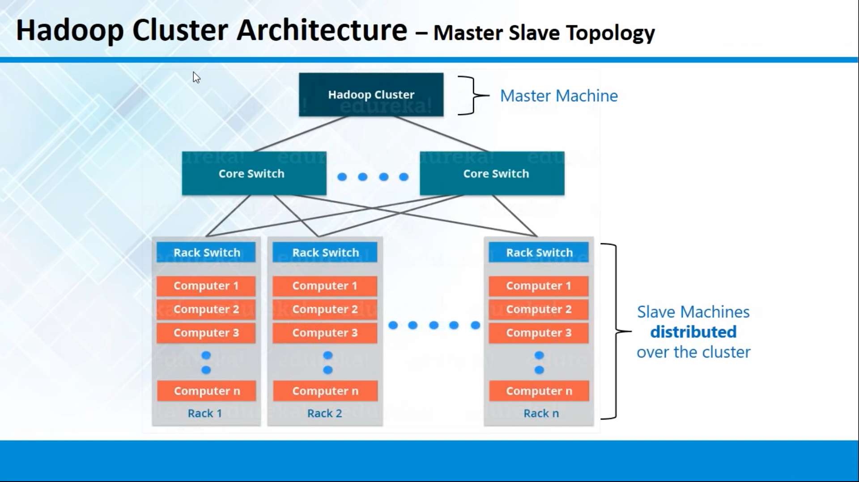

Slide 30
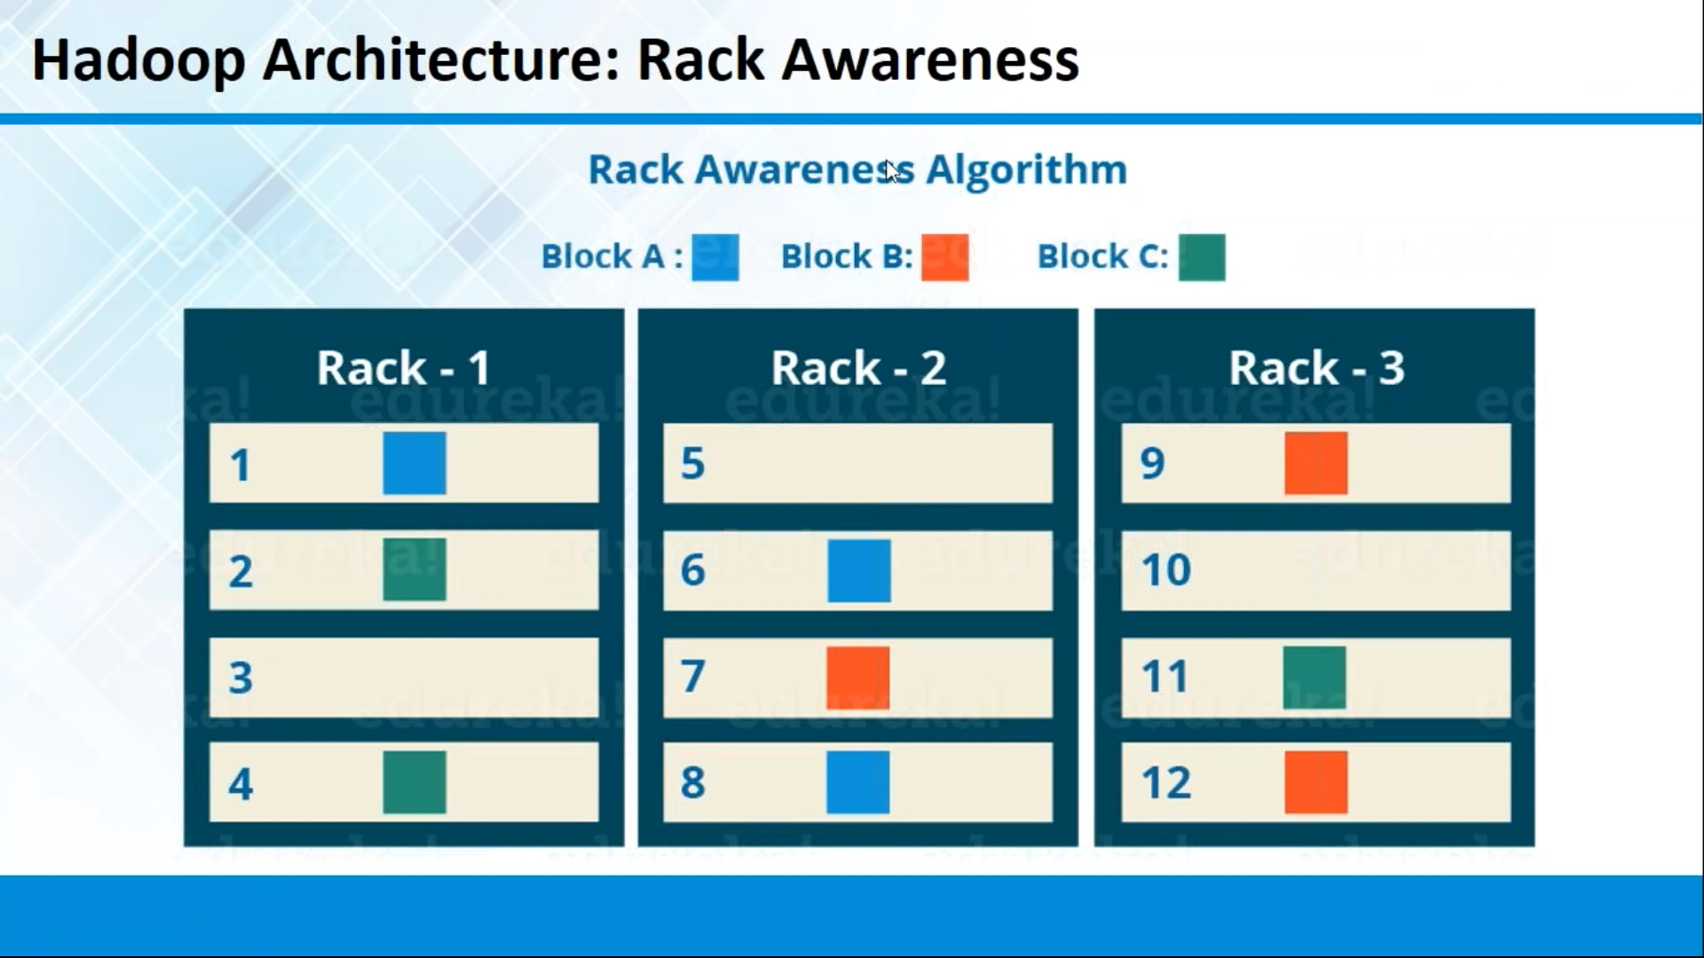

Slide 31
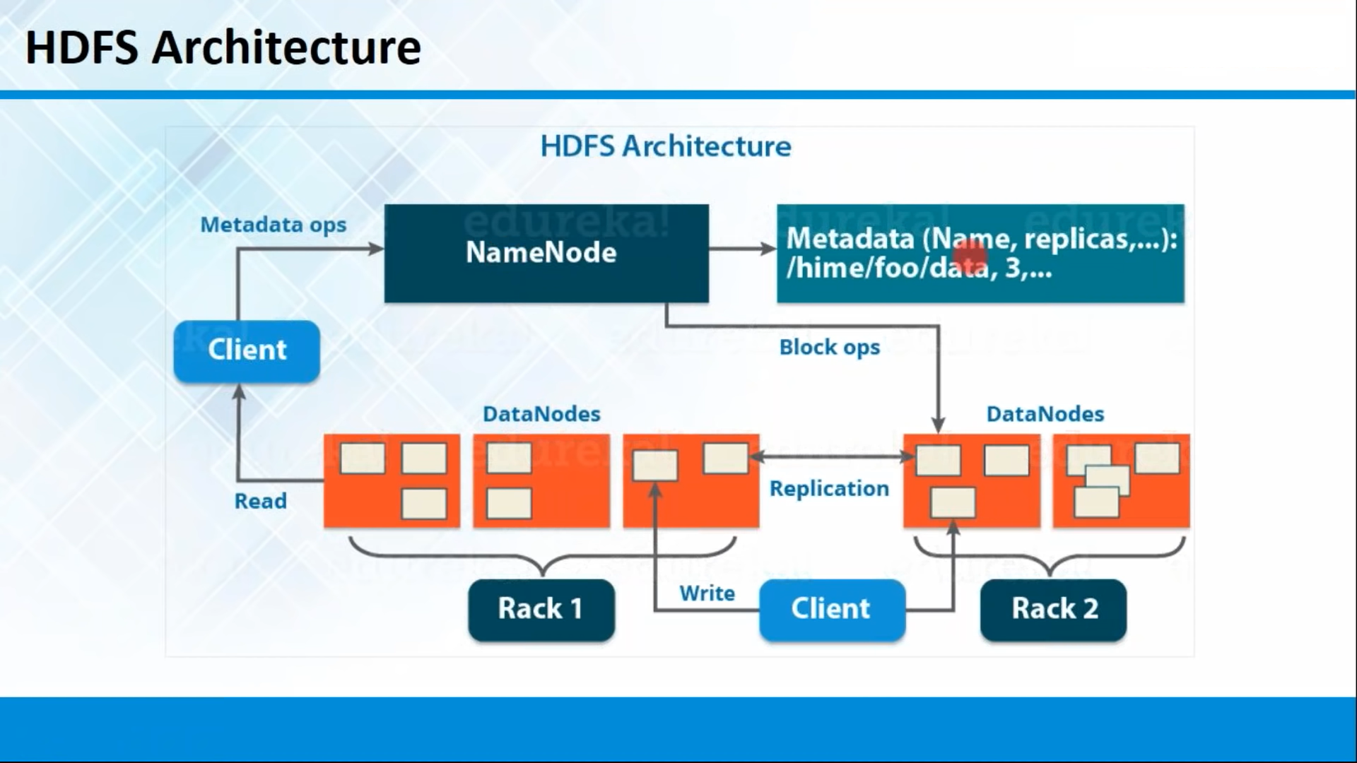

Slide 32
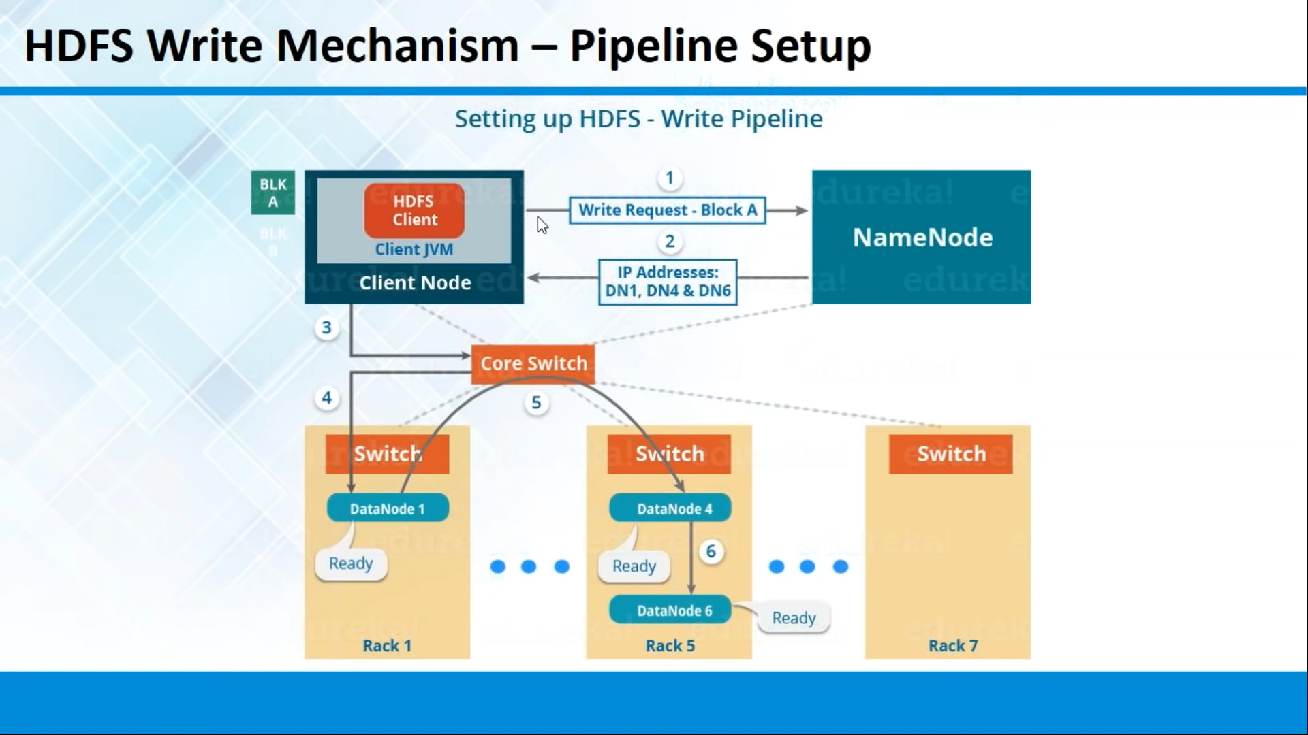

Slide 33
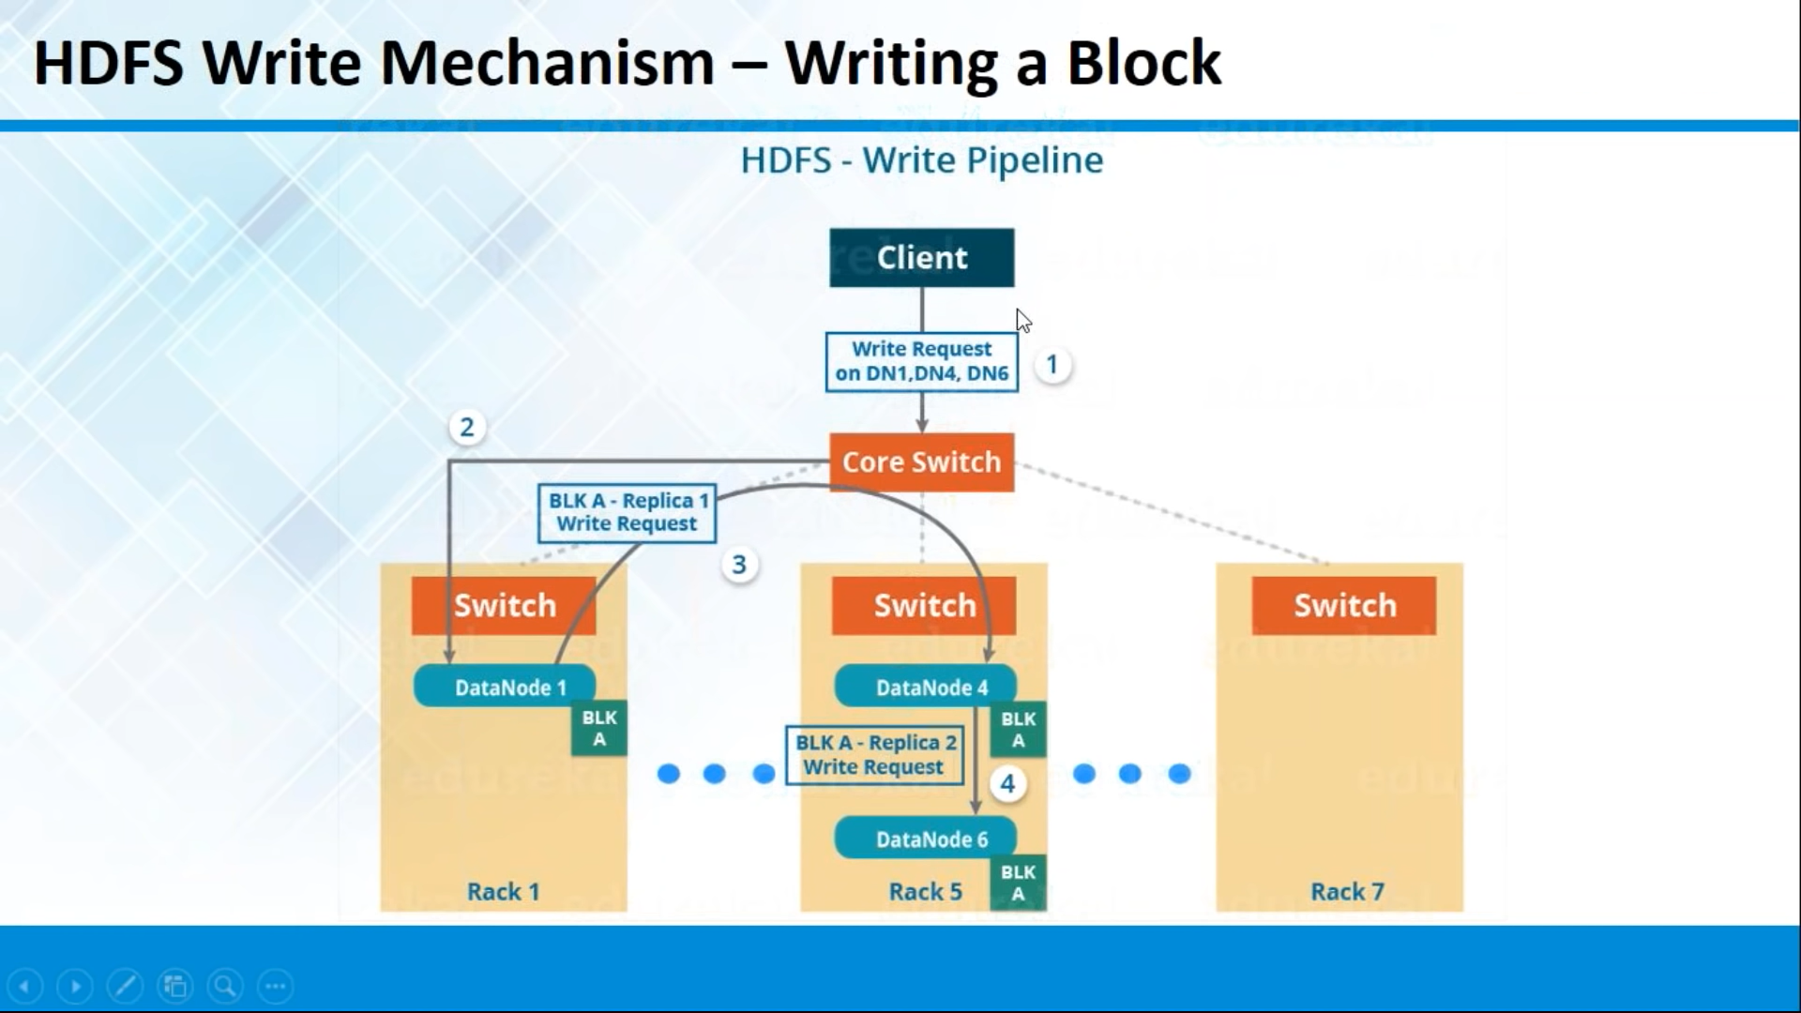

Slide 34
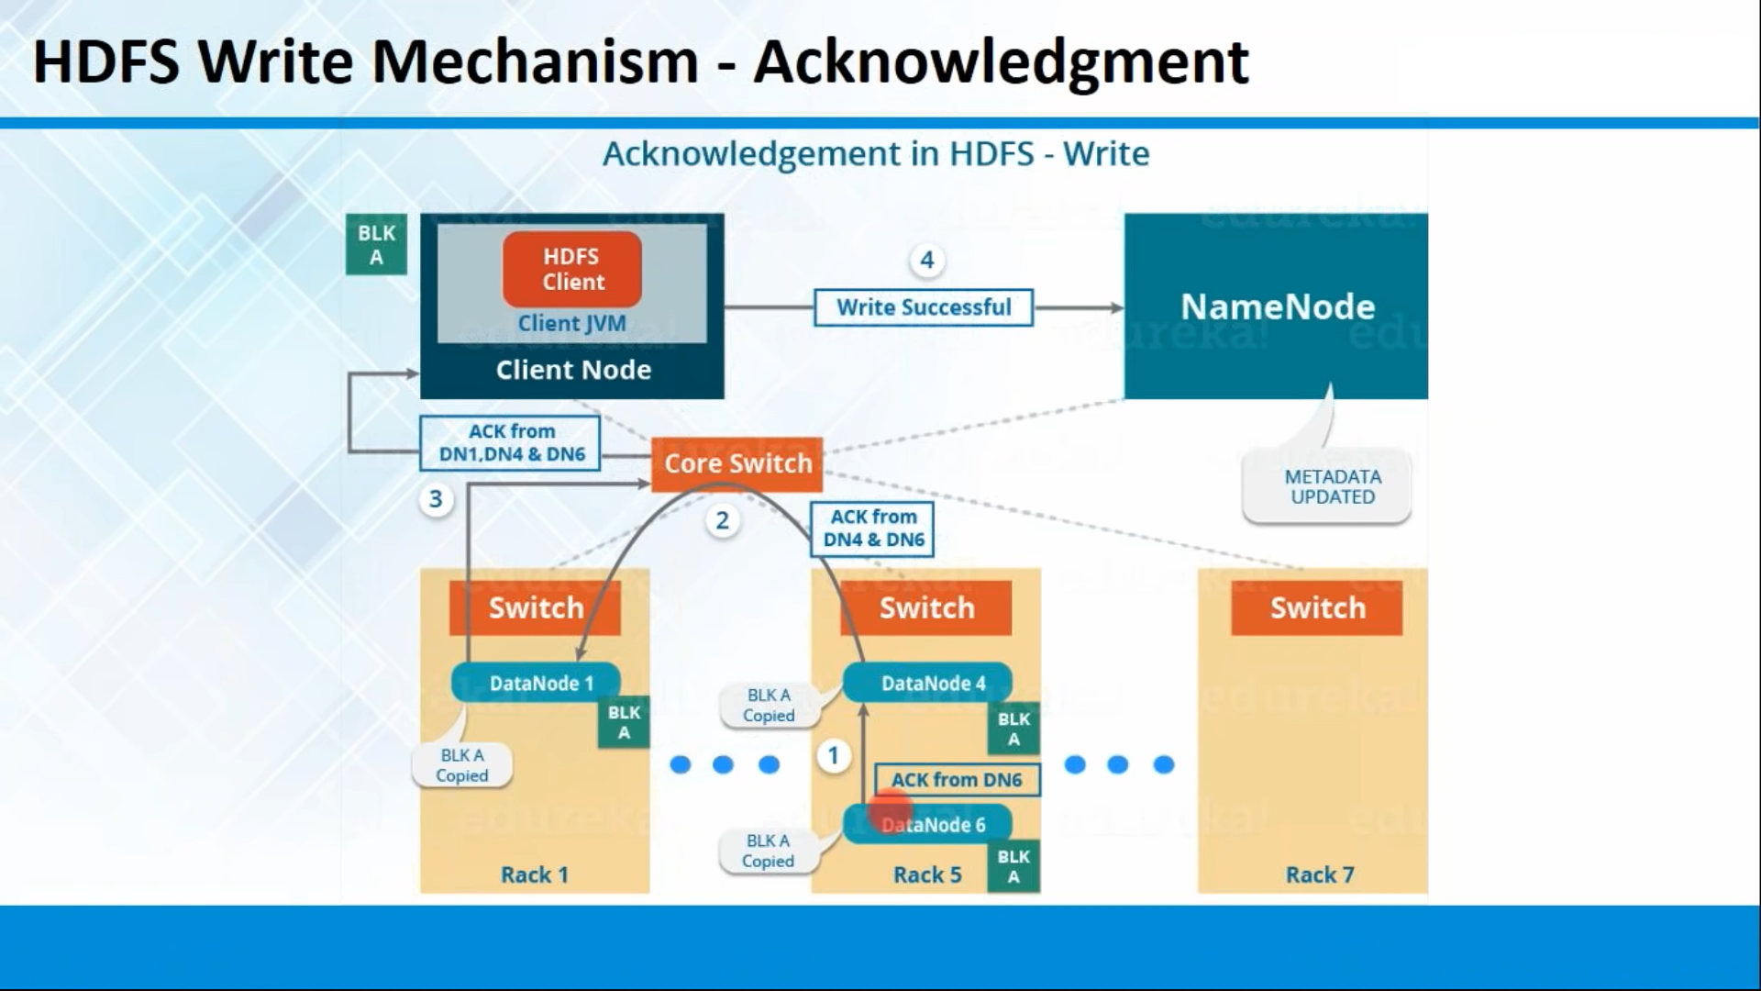

Slide 35
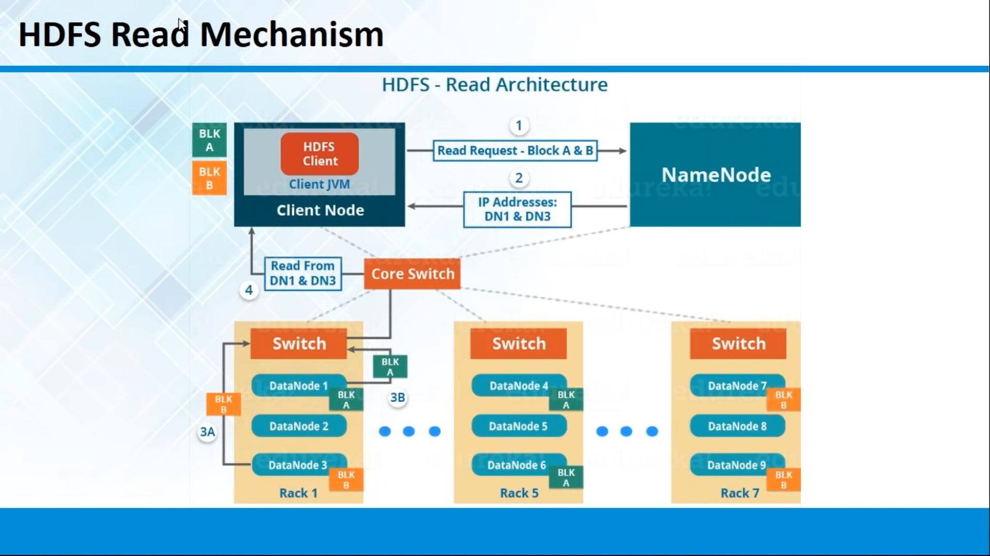

Slide 36
Mapreduce
Job Tracker and Task Tracer are the components of MapReduce.
Job Tracker always available on Master
The JobTracker is the service within Hadoop that farms out MapReduce tasks to specific nodes in the cluster, ideally the nodes that have the data.
The JobTracker submits the work to the chosen TaskTrackers nodes.
TaskTrackers is always available on all the slave nodes
TaskTrackers is a node in the cluster that accepts tasks from JobTracker

Slide 37
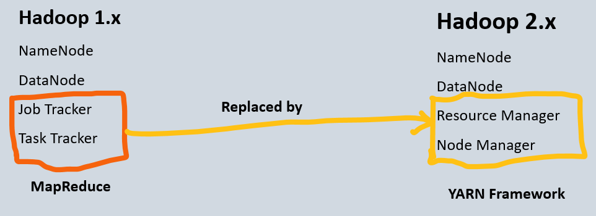
1.0 vs 2.0

Slide 38
1.0 vs 2.0
1.0
Name Node
Data Node
Job Tracker
Task Tracker
2.0
Name Node
Data Node
Resource Manager
Node Manager

Slide 39
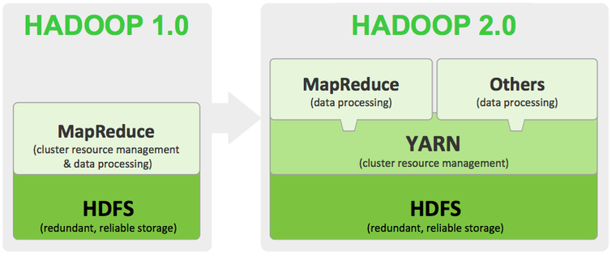
1.0 vs 2.0

Slide 40
1.0 vs 2.0
Because of limitations that will be there in 1.0, it will accept java as input unit
Job tracker will accept the input only as java language
In Hadoop Java programming guys only able to work on this architecture
In 2.0 YARN it will accept the input as multi programming language and software's
Ex: Python/Hive

Slide 41
Datacentre
Datacenter are group of servers avail for storing and retrieving data in same location
Datacentre Rack
rack is the electronic framework of switches assembling different servers in datacenter

